Slide 1
Object Tracking

Slide 2
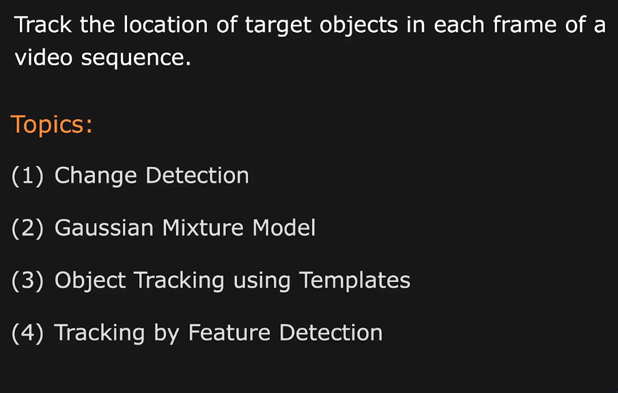
Object Tracking

Slide 3
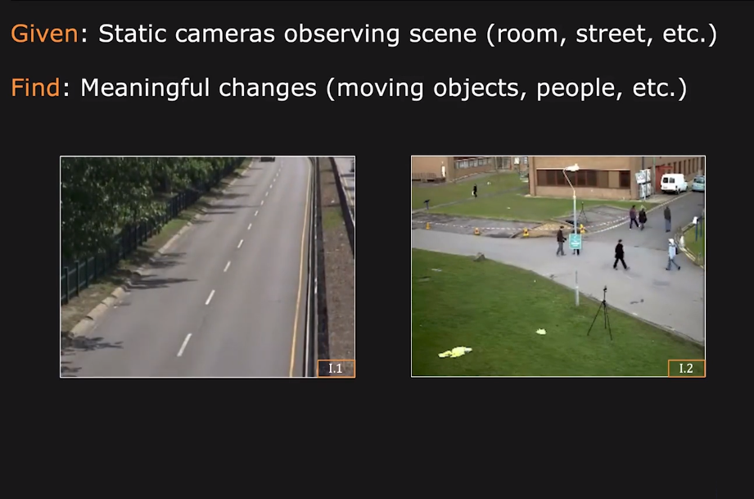
Change Detection

Slide 4
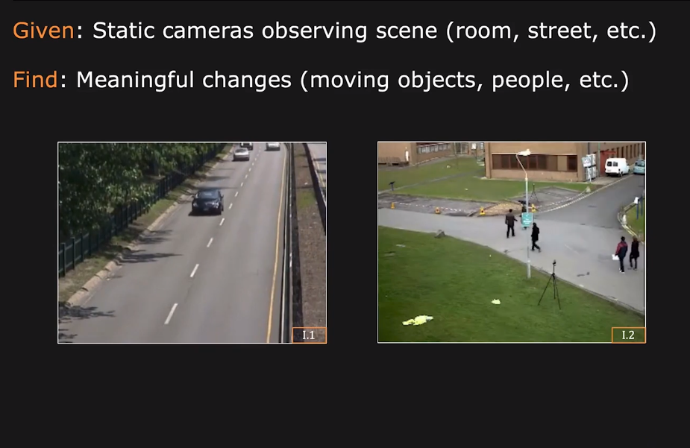
Change Detection

Slide 5
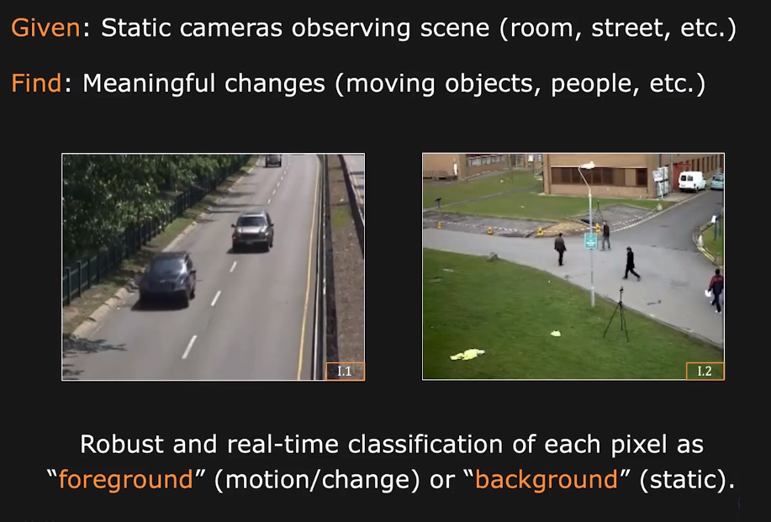
Change Detection

Slide 6
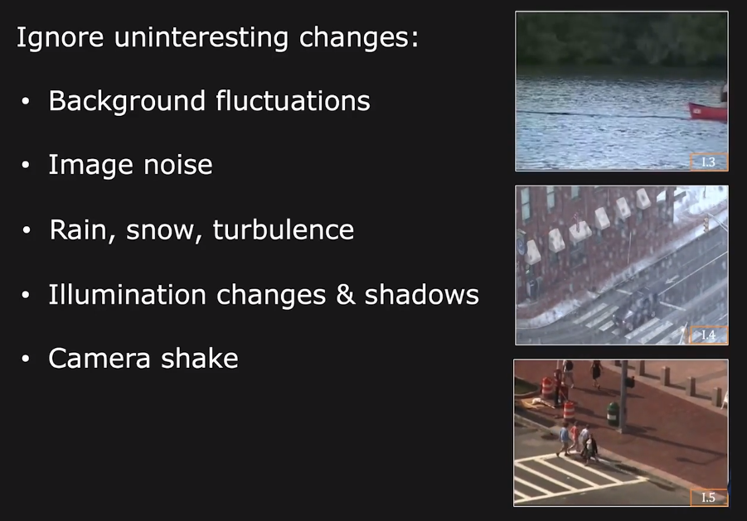
Change Detection: Challenges

Slide 7
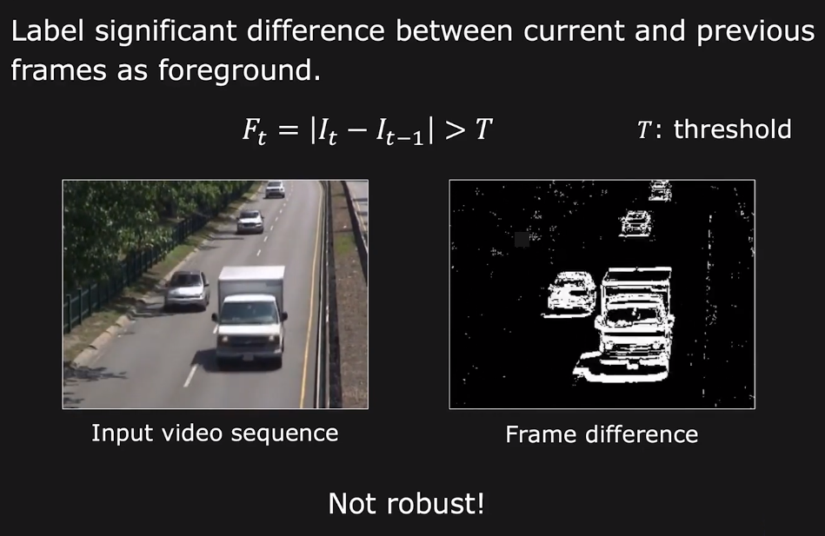
Simple Frame Difference

Slide 8
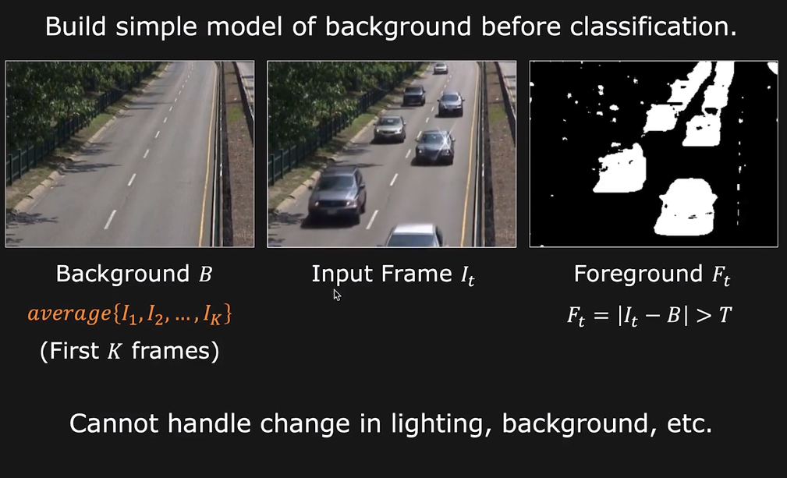
Background Modeling: Average

Slide 9
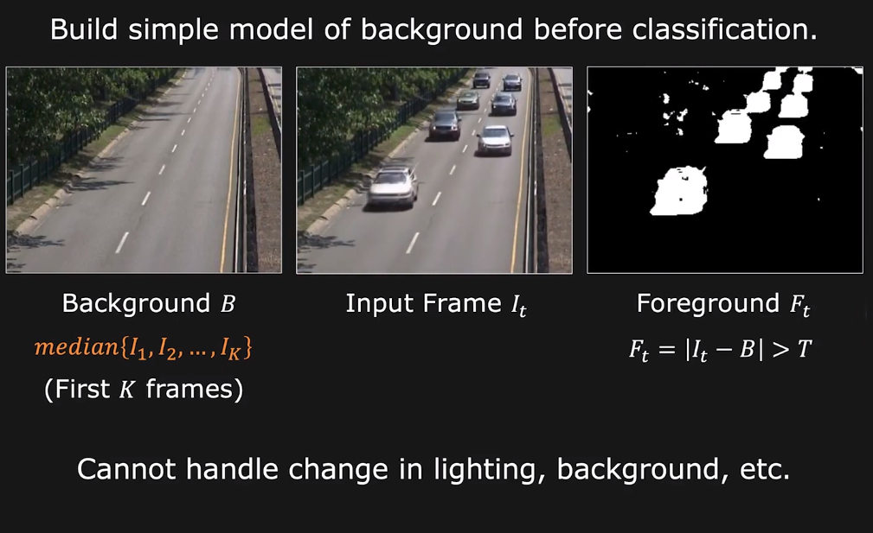
Background Modeling: Average

Slide 10
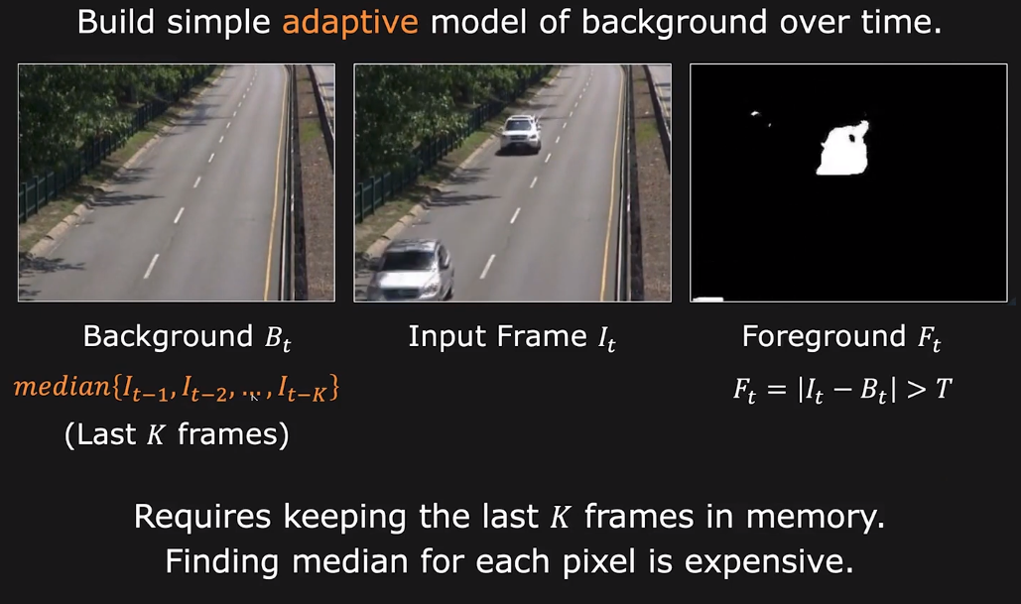
Background Modeling: Moving Average

Slide 11
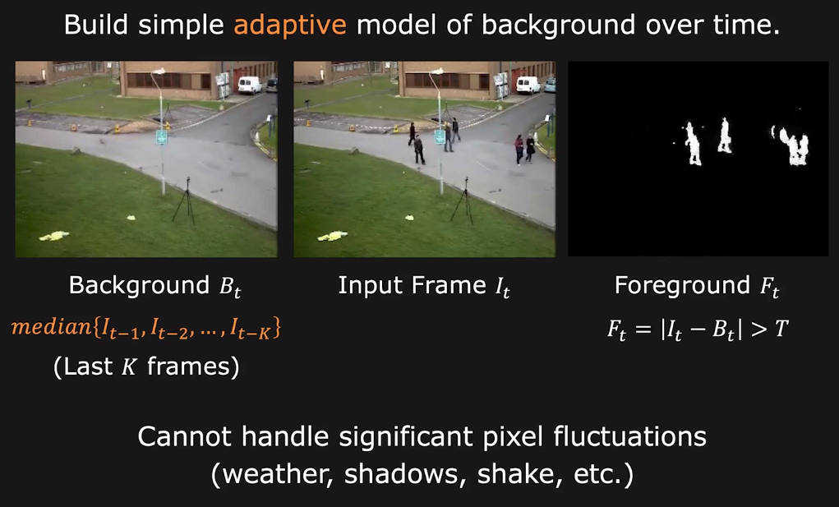
Background Modeling: Moving Average

Slide 12
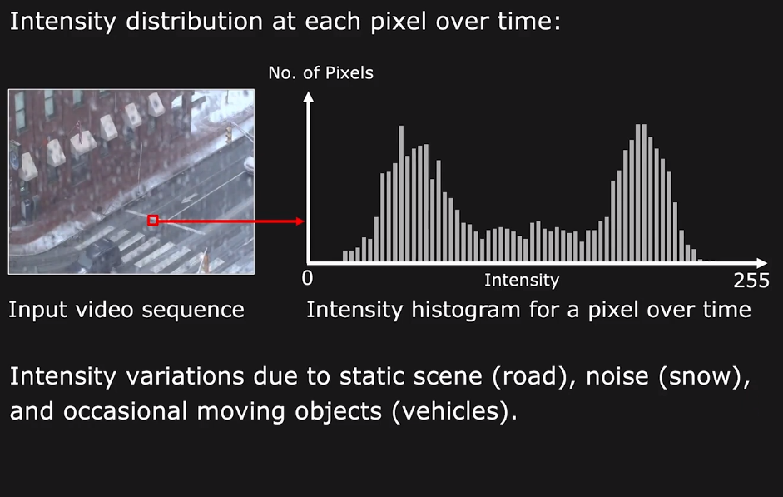
Mixture Model

Slide 13

Mixture Model

Slide 14
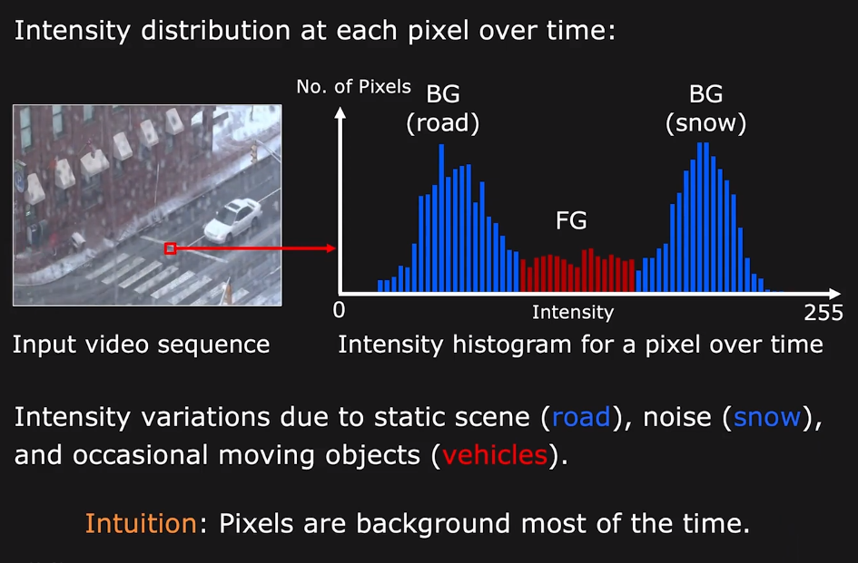
Mixture Model

Slide 15
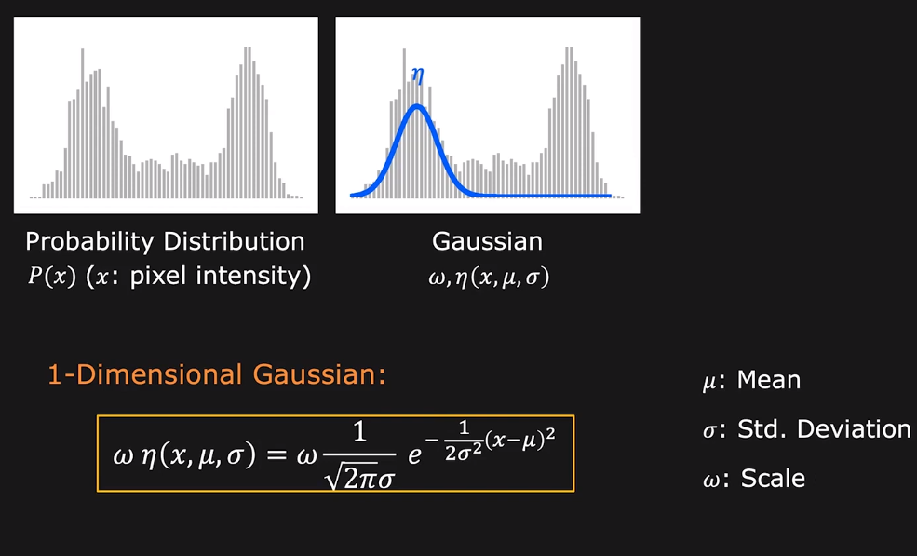
Mixture Model

Slide 16
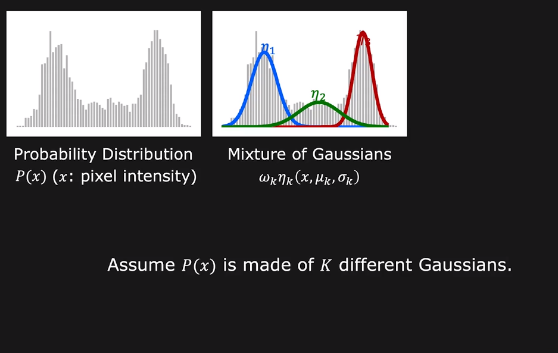
Mixture of Gaussians

Slide 17
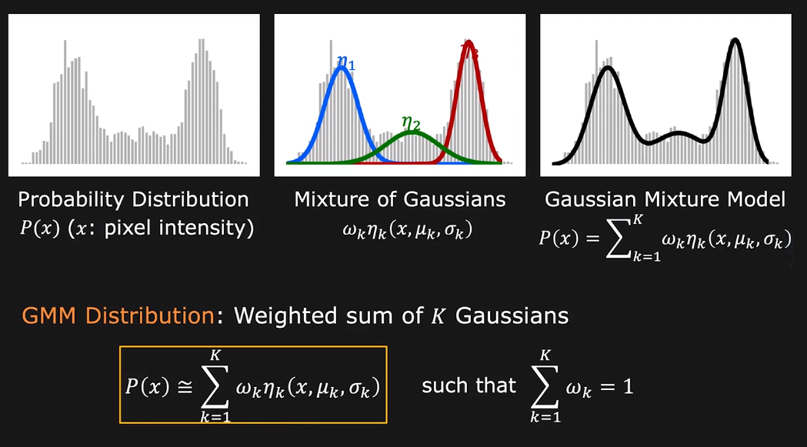
Gaussian Mixture Model (GMM)

Slide 18
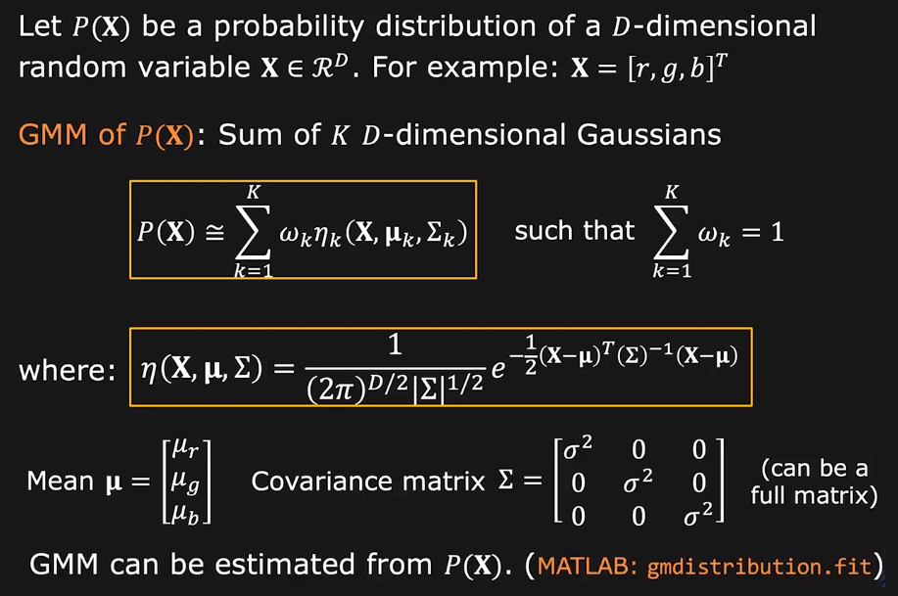
High Dimensional GMM

Slide 19
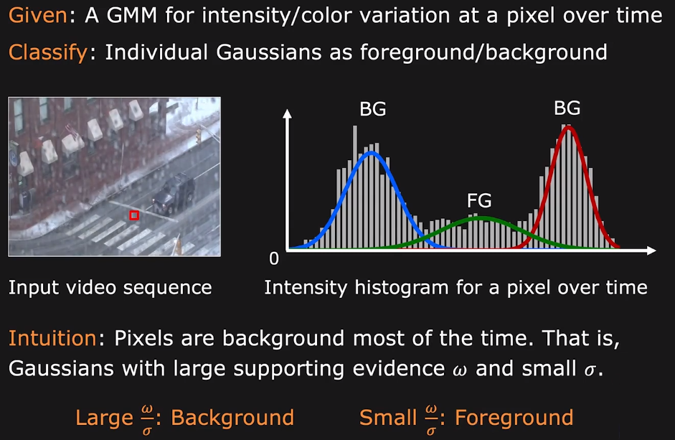
Background Modeling with GMM

Slide 20
Thanks

